Slide 1
Introduction to Deep Learning on ShARC and DGX-1 Day 1
Twin Karmakharm
16th February 2017

Slide 2
For Slides and Lab materials
http://gpucomputing.shef.ac.uk/education
“More” link under -> Introduction to Deep Learning on ShARC DGX-1

Slide 3
Course content
Day 1
Lab 00: Getting started
Machine Learning and Neural Network Refresh
Introduction to Deep Learning
Lab 01: A simple Neural Network model for MNIST classification
Lab 02: Convolution Neural Networks
Lab 03: Deploying Your Trained Network

Slide 4
Course content
Day 2
Lab 04: Using and Visualising Pre-trained Models
Lab 05: Deep Learning with multiple GPUs
Lab 06: Recurrent Neural Networks

Slide 5
Practical Lab 00

Slide 6
Machine Learning and Neural Network Refresh

Slide 7
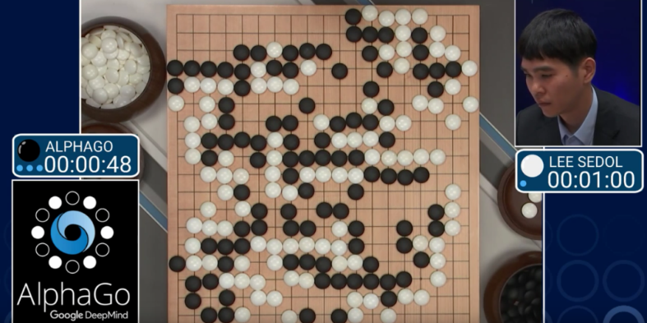
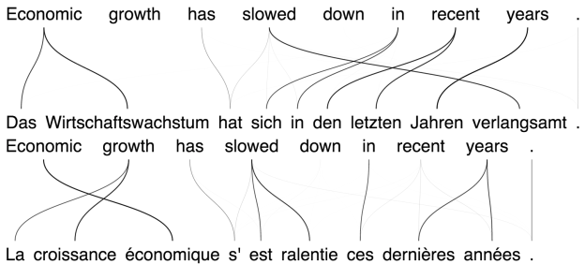
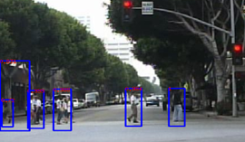
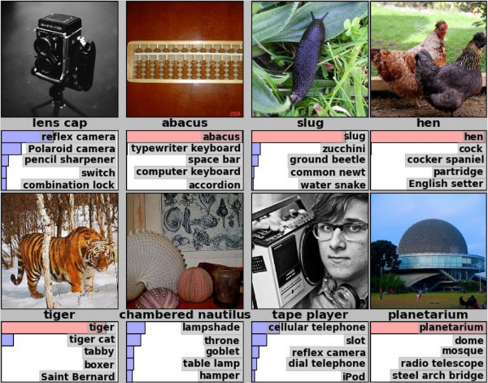
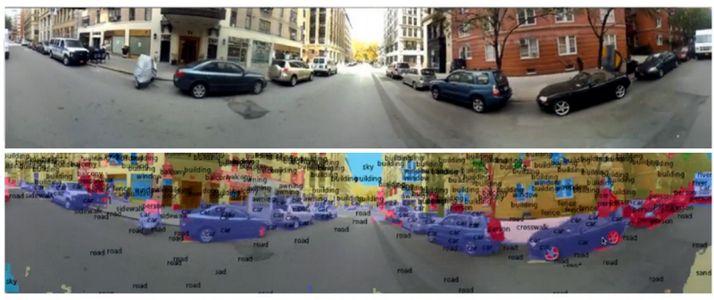
What is Machine Learning (ML)?
Ability to teach a computer without explicitly programming it
Used for tasks which are difficult to program for
3.
5.
1.
2.
4.
1. https://news.developer.nvidia.com/real-time-pedestrian-detection-using-cascades-of-deep-neural-networks
2. http://danielnouri.org/notes/2014/01/10/using-deep-learning-to-listen-for-whales/
3. https://deepmind.com/research/alphago/
4. http://www.33rdsquare.com/2015/01/what-do-you-need-to-know-about-deep.html
5. https://devblogs.nvidia.com/parallelforall/introduction-neural-machine-translation-gpus-part-3/

Slide 8
What is ML used for?
Handwriting Recognition
convert written letters in to digital letters
Language Translation
translate spoken and or written languages (e.g. Google Translate)
Speech Recognition
convert voice snippets to text (e.g. Siri, Cortana, and Alexa)
Image Classification
label images with appropriate categories (e.g. Google Photos)
Autonomous Driving
enable cars to drive

Slide 9
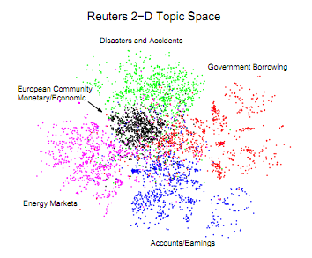
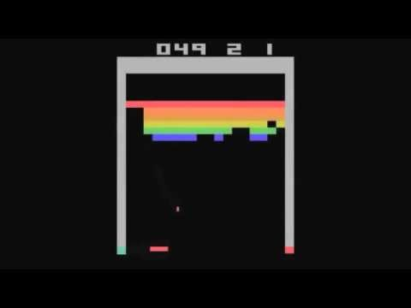
Types of Learning
Supervised learning
Training data is labelled
Maps data to label
Unsupervised learning
Training data has no labels
Finds patterns within data
Reinforcement learning
Training data has no labels but system gets reward value(s)
Fitting for reward maximisation

Slide 10

Neural Networks
Biologically inspired

Slide 11
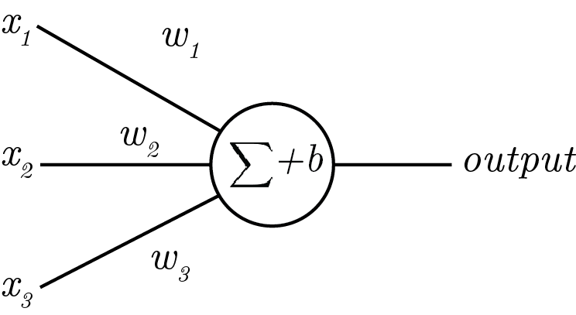
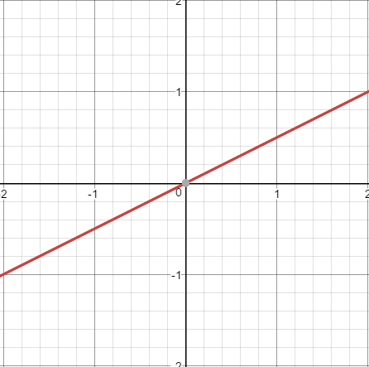
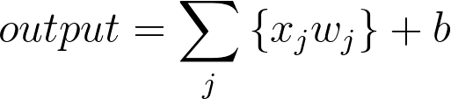
A Neuron (Perceptron)
Output is a sum of all input plus bias

Slide 12
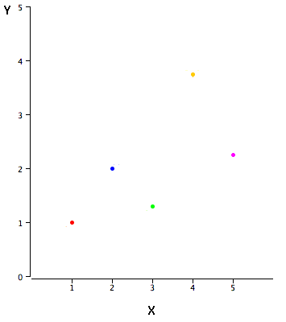
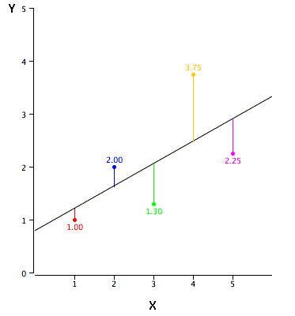
Linear Regression
Fitting an optimal line through a data set by minimising error
[http://onlinestatbook.com/2/regression/intro.html]

Slide 13
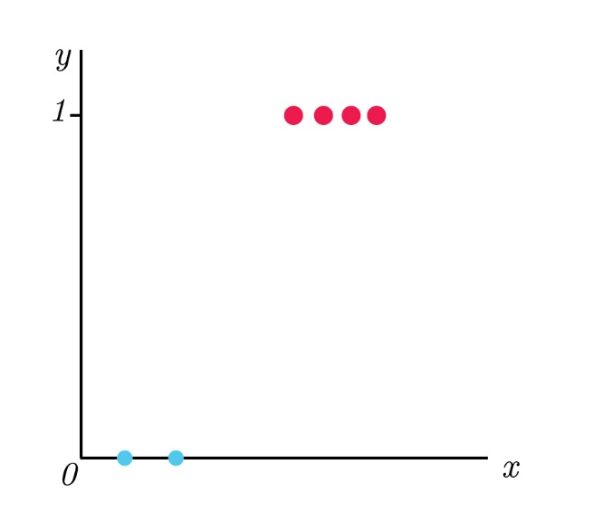
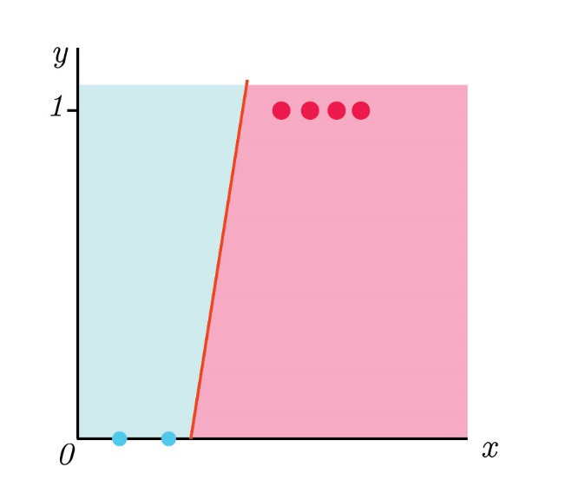
Logistic regression
Classifying the data set
Can use linear function, but not ideal
We would like a binary result, is it ‘red’ or ‘blue’?

Slide 14
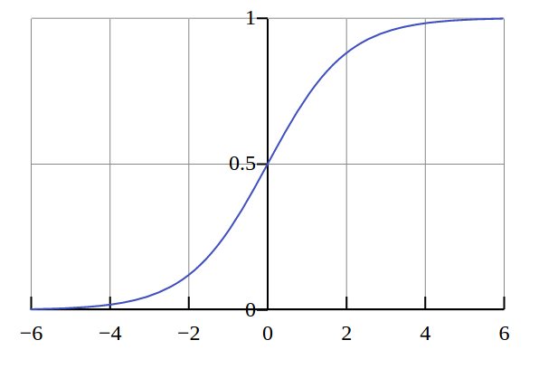
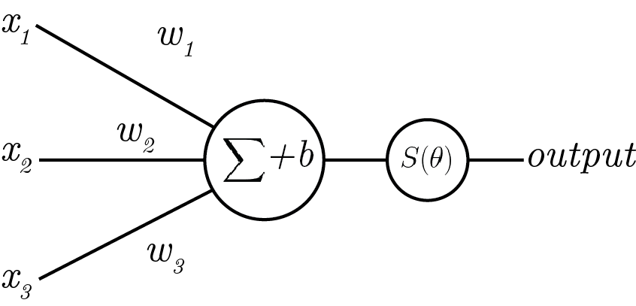
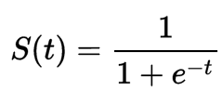
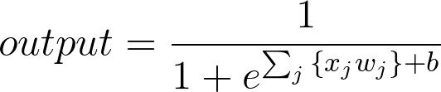
Neuron with non-linear activation
Apply non-linearity over output (Sigmoid in this case)
Output is between 0 and 1, value in between is ‘confidence’
Sigmoid activation

Slide 15
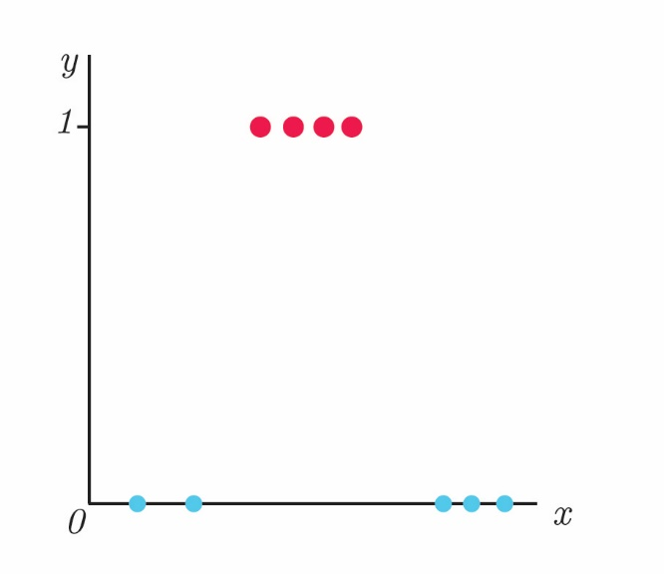
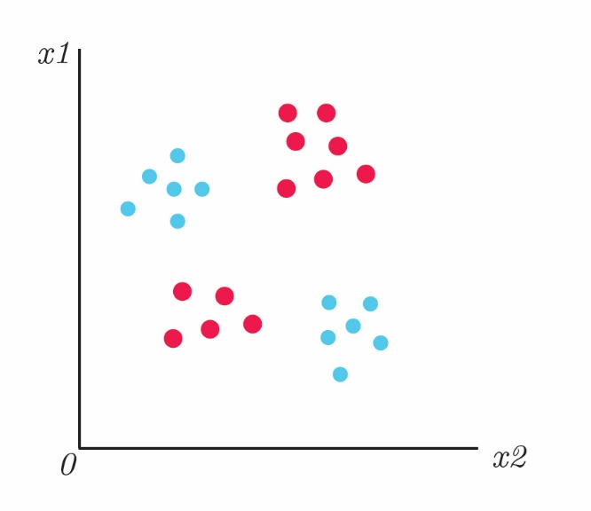
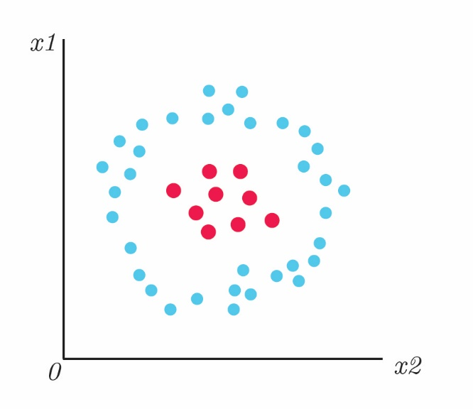
Logistic regression
Non-linearity allows us to classify more complex problems

Slide 16
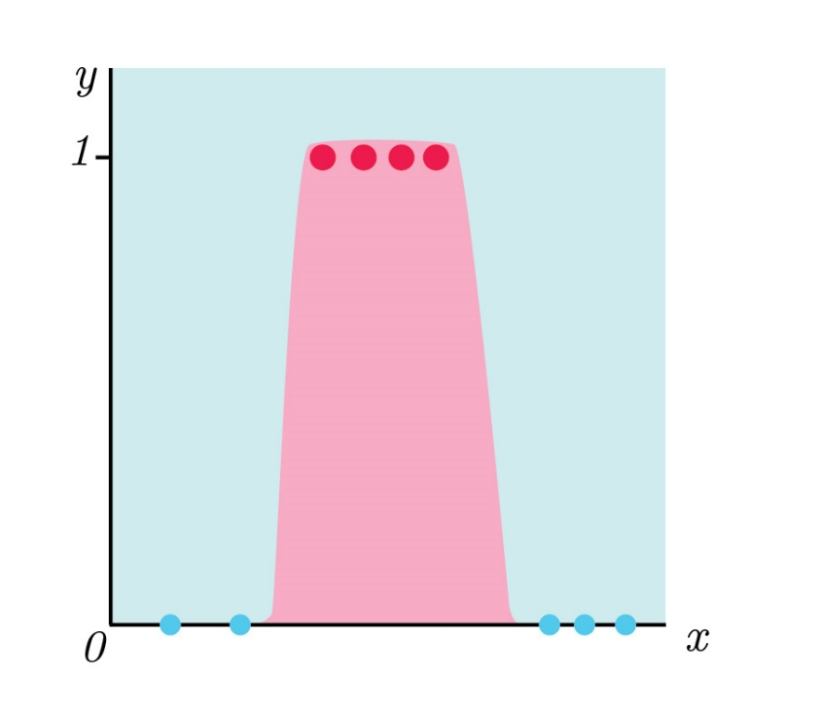
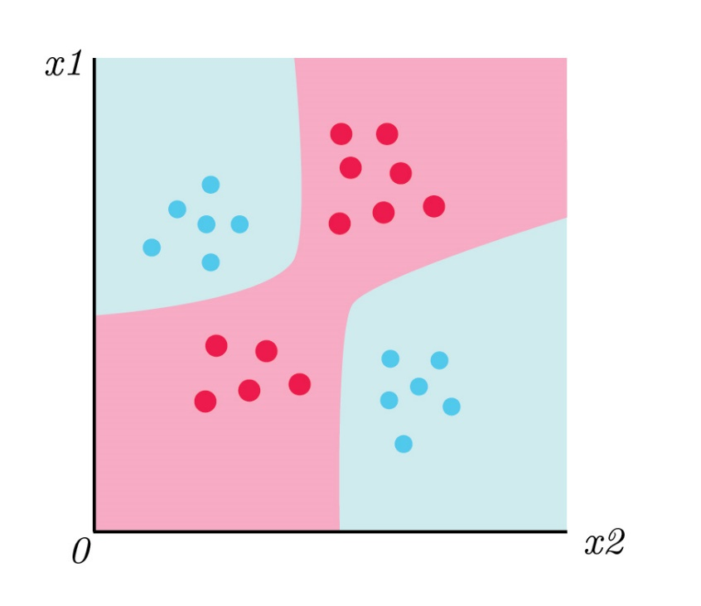
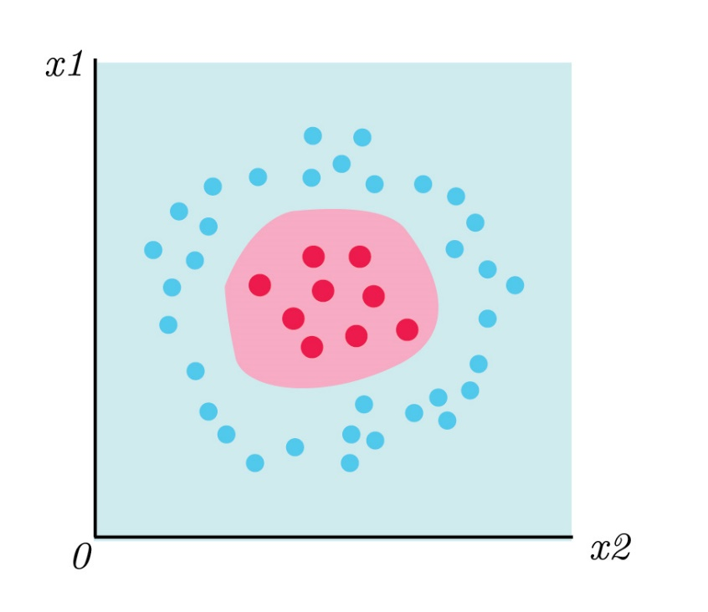
Logistic regression
By adding non-linearity

Slide 17
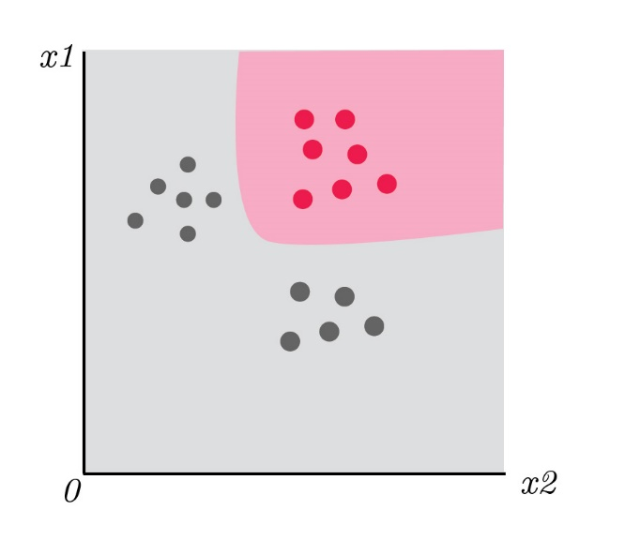
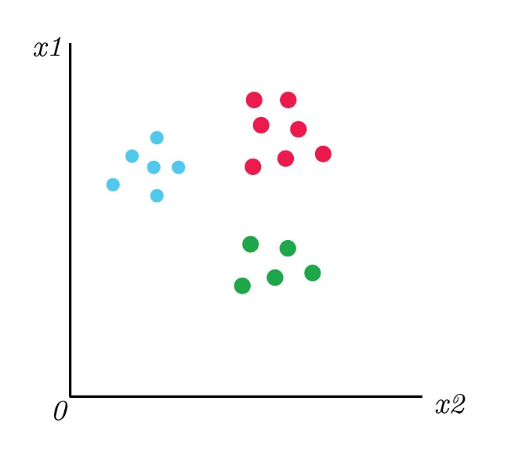
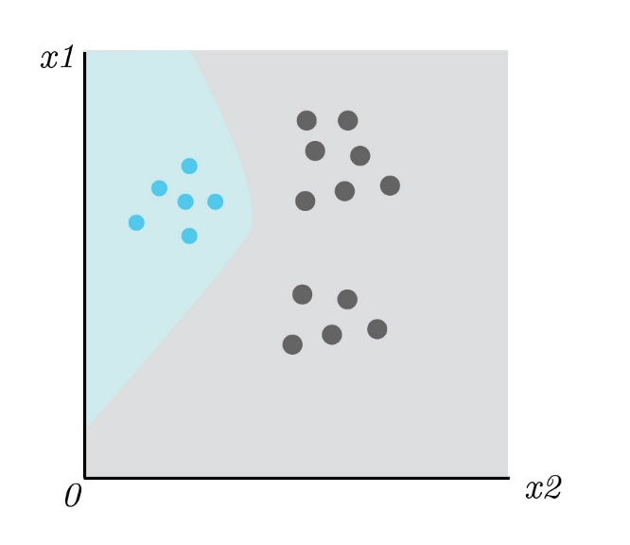
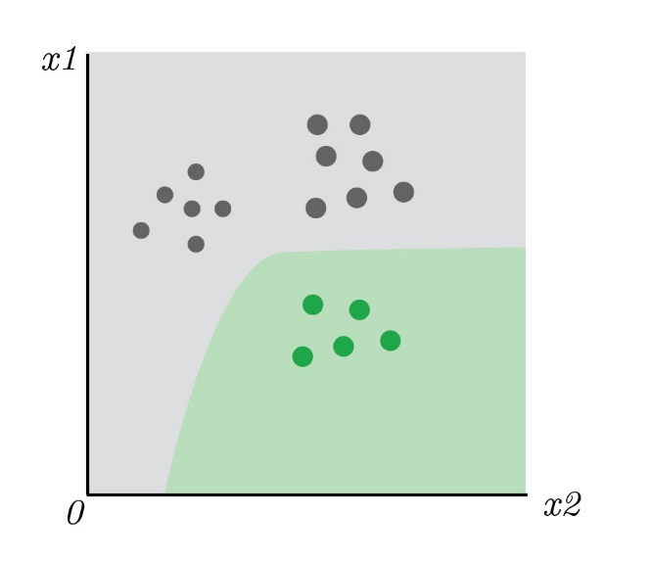
Multi-class logistic regression
Classify each separately
One NN output for each classification

Slide 18
Neural Networks
Input Layer
Hidden Layer
Output Layer
Neuron
Synapse

Slide 19
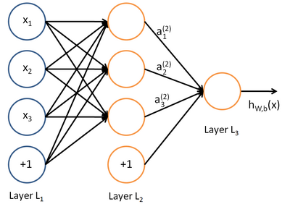
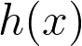
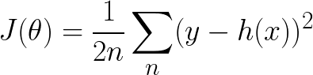
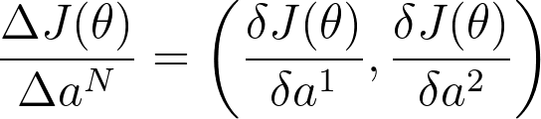
NN Training
1. Forward propagation with a data sample.
2. Find loss
E.g. for hypothesis
4. Repeat with different sample.
Mean squared loss
3 Back propagation.
Find partial derivatives with respect to the weights
Notes:
\frac{\Delta J(\theta)}{\Delta a^N} = \left ( \frac{\delta J(\theta)}{\delta a^1} ,\frac{\delta J(\theta)}{\delta a^2} \right )

Slide 20
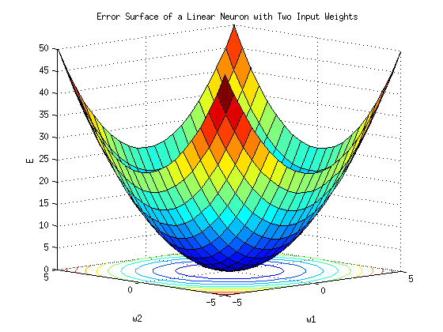
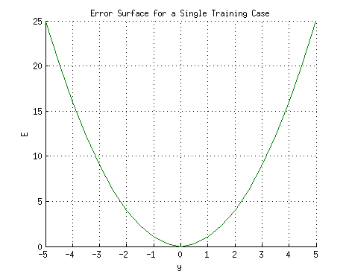
NN Training – Linear function, convex error
Guaranteed to reach a global minimum.

Slide 21
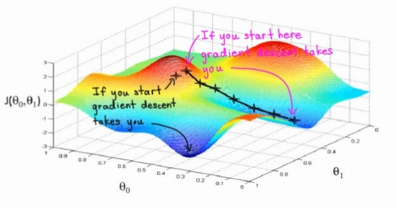
NN Training – Non-linear function, non-convex error
May get stuck in a local minimum.
But for large networks:
Many local minimum are equivalent to global minimum.
Global minimum often leads to overfitting.
[Chromanska 2014]
[Andrew Ng – Machine Learning module]

Slide 22
Introduction to Deep Learning

Slide 23

What is Deep Learning (DL)?
A sub-category of Machine Learning
Uses neural networks with many layers
Hierarchy of representation/feature extractors
[Alexnet – Krizhevsky et al. 2012]

Slide 24
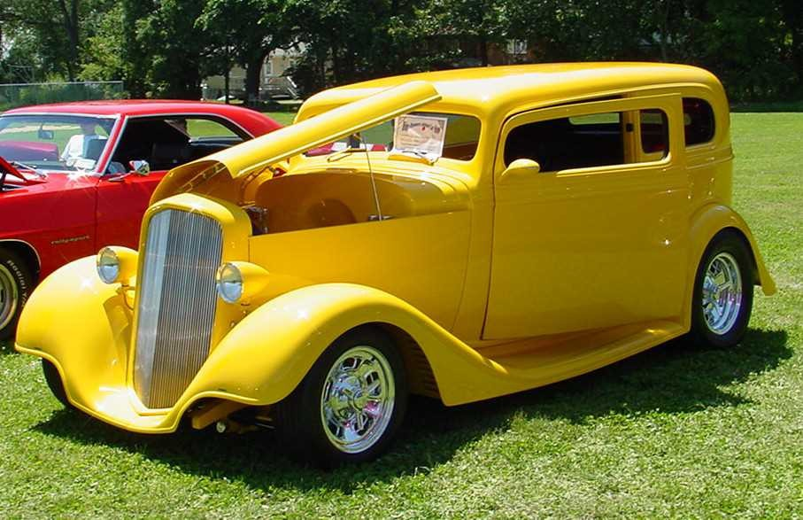
DL – Learning representation/features
Learning representations/features
The traditional model of pattern recognition (since the late 50's)
Fixed/engineered features (or fixed kernel) + trainable classifier
End-to-end learning / Feature learning / Deep learning
Trainable features (or kernel) + trainable classifier
Hand-crafted Feature Extractor
“Simple” Trainable Classifier
Trainable Feature Extractor
Trainable Classifier

Slide 25
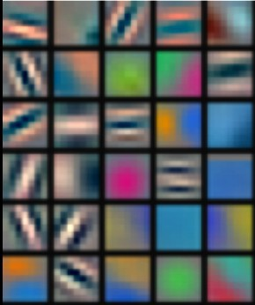
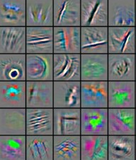
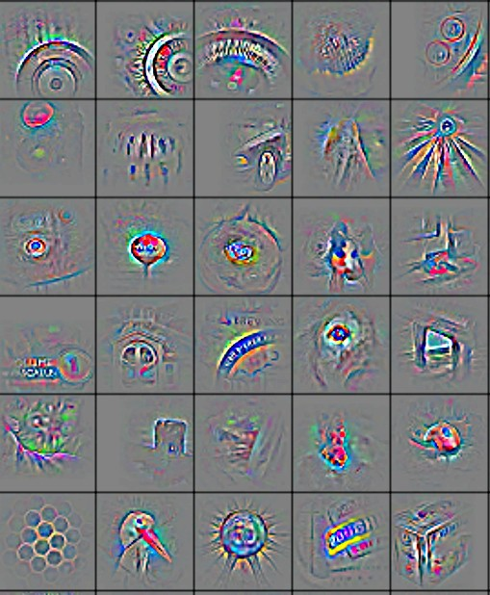
DL – Learning representation/features
Hierarchy of features
Low-level feature
Mid-level feature
High-level feature
Trainable classifier
Feature visualization of convolutional net trained on ImageNet from [Zeiler & Fergus 2013]

Slide 26
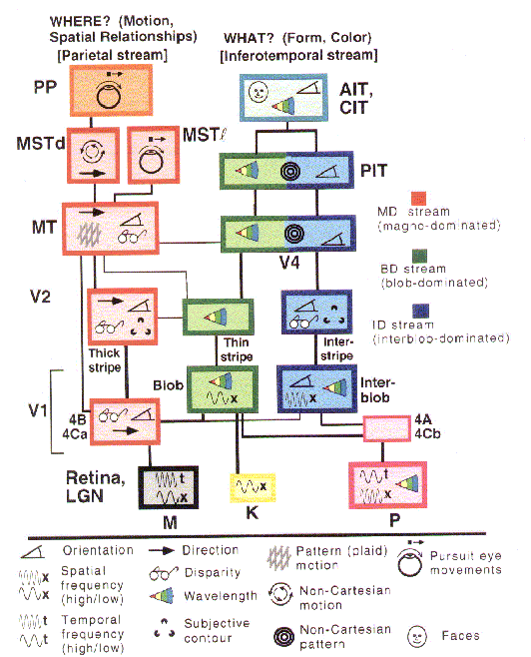
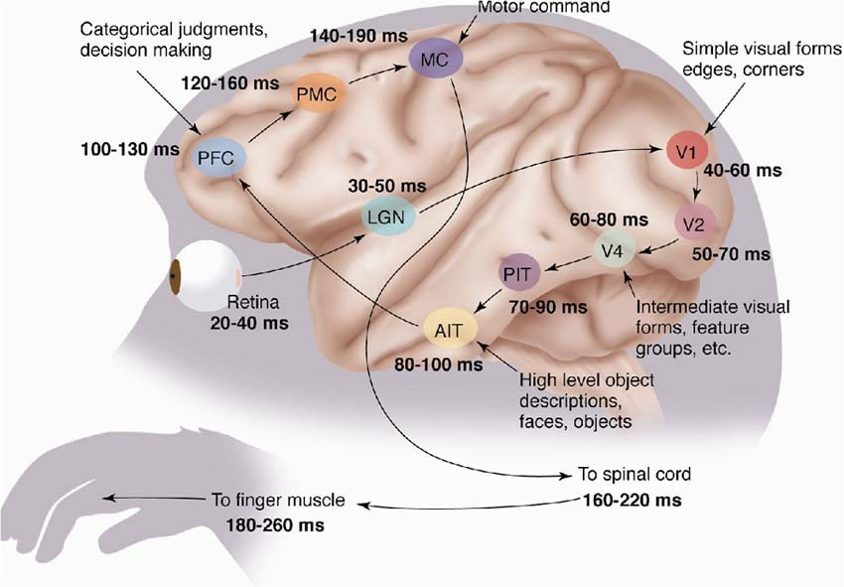
The mammalian visual cortex is hierarchical
The ventral (recognition) pathway in the visual cortex has multiple stages Retina - LGN - V1 - V2 - V4 - PIT - AIT ....
Lots of intermediate representations
[picture from Simon Thorpe]
[Gallant & Van Essen]

Slide 27
Why use deep architectures
A NN with 1 hidden layer can computer any function given unlimited hidden units
A deep architecture trades space for time (or breadth for depth)
More layers (more sequential computation),
But less hardware (less parallel computation).
But deep NNs have been shown to be able to map more complex functions with same number of hidden units [Bianchini et al. 2014]
Layers can act as encoders reducing data dimensionality

Slide 28
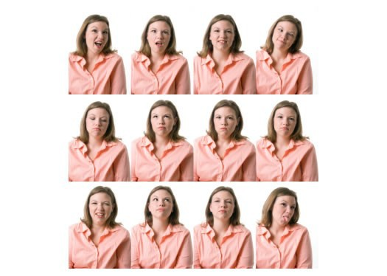
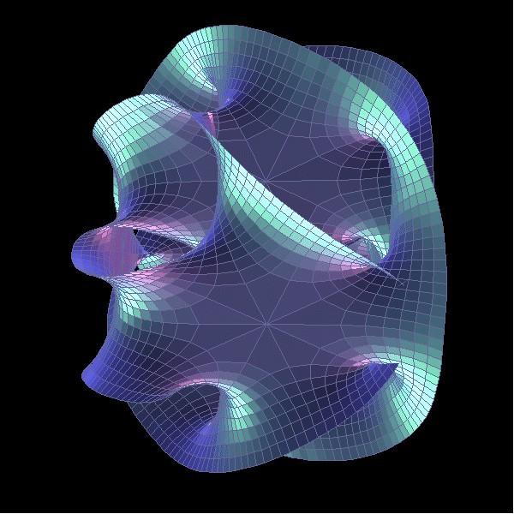
Why use deep architectures: Feature extraction
The manifold hypothesis:
Natural data lives in a low-dimensional (non-linear) manifold
Because variables in natural data are mutually dependent

Slide 29

Why use deep architectures: Feature extraction
The manifold hypothesis:
Natural data lives in a low-dimensional (non-linear) manifold
Because variables in natural data are mutually dependent
1.2 | Face/not face
-3 | Pose
0.2 | Lighting
-2… | Expression
Ideal feature extractor

Slide 30
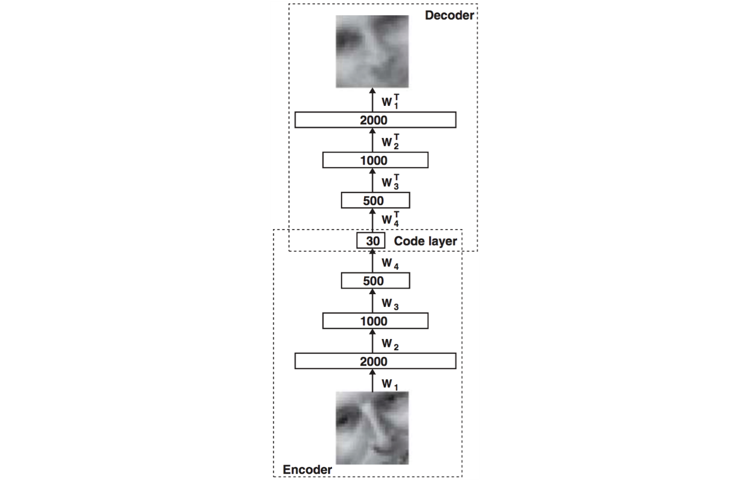
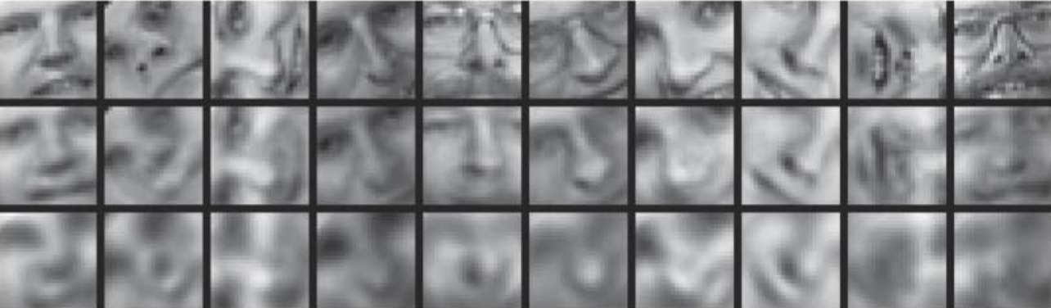
Why use deep architectures: Feature extraction
A NN Autoencoder
Original
NN Autoencoder
PCA

Slide 31



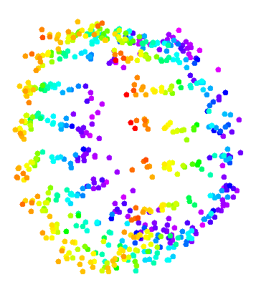

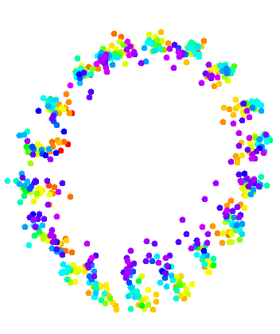
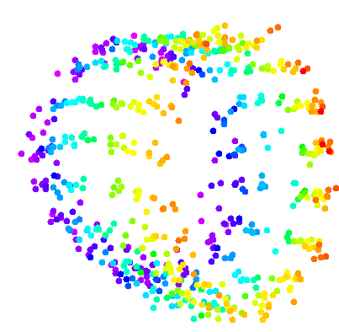







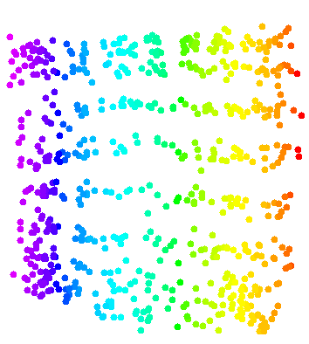
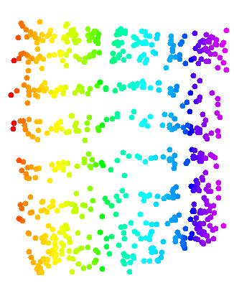









Data manifold & invariance: Some variations must be eliminated
Azimuth-Elevation manifold. Ignores lighting. [Hadsell et al. CVPR 2006]

Slide 32

Overall architecture: Normalization → filter bank → non-linearity → pooling
Filter Bank
Non- Linear
feature Pooling
Filter Bank
Non- Linear
feature Pooling
Norm
Norm
Classifier
Stacking multiple stages of
[Normalization → filter bank → non-linearity → pooling].
Normalization: variations on whitening
Subtractive: average removal, high pass filtering
Divisive: local contrast normalization, variance normalization
Filter bank: dimension expansion, projection on overcomplete basis
Non-linearity: sparsification, saturation, lateral inhibition....
Rectification (relu), component-wise shrinkage, tanh, winner-takes-all
Pooling: aggregation over space or feature type

Slide 33
In many fields, feature learning has caused a revolution (methods used in commercially deployed systems)
Speech Recognition I (late 1980s)
Trained mid-level features with Gaussian mixtures (2-layer classifier)
Handwriting Recognition and OCR (late 1980s to mid 1990s)
Supervised convolutional nets operating on pixels
Face & People Detection (early 1990s to mid 2000s)
Supervised convolutional nets operating on pixels (YLC 1994, 2004, Garcia 2004)
Haar features generation/selection (Viola-Jones 2001)
Object Recognition I (mid-to-late 2000s: Ponce, Schmid, Yu, YLC....)
Trainable mid-level features (K-means or sparse coding)
Low-Res Object Recognition: road signs, house numbers (early 2010's)
Supervised convolutional net operating on pixels
Speech Recognition II (circa 2011)
Deep neural nets for acoustic modeling
Object Recognition III, Semantic Labeling (2012, Hinton, YLC,...)
Supervised convolutional nets operating on pixels

Slide 34





Why use GPUs?
GPUs have massively parallel architecture
Designed for parallel floating point and matrix operations
NNs are essentially large floating point and matrix multiplication problems

Slide 35


Why use GPUs?
Even inexpensive consumer hardware can be used to massively speed up calculation
GPU makers are creating low-level frameworks optimised for NN computation e.g. cuDNN
Support in most DL packages

Slide 36
The ShARC cluster
New High Performance Computing (HPC) cluster, is now live
124 Normal memory nodes
2x8 core processor (64GB RAM, 4GB per processor)
4 Large memory nodes
2x8 core processor (256GB RAM, 16GB per processor)
8 GPU units with Nvidia K80

Slide 37



The DGX-1
8xNvidia P100 GPUs (16GB each) – 170TFLOPS of computation
Dual 20-core Intel Xeon E5-2698 v4 2.2Ghz
512GB RAM
Cube Mesh NVLink interconnects - 732GB/s total

Slide 38

Deep Learning Platforms & Frameworks
Supported on ShARC
Theano – Python, low-level
Tensorflow – Python, low-level with some built-in DL features
Caffe – High-level, CLI, C++ with Python and Matlab interface
Torch – High-level, LUA interface
High-level Wrappers
Keras – Theano & Tensorflow
Lasanga (for Theano)
Sklearn-theano
DIGITS

Slide 39
Deep Learning Platforms & Frameworks
Many others are also available including:
MatConvNet
Mxnet
Deeplearning4j
Chainer
CNTK

Slide 40
1. A basic NN model
Handwritten digits identification from the MNIST dataset

Slide 41


MNIST Dataset
Images of handwritten digits 0-9
10 classifiers
28x28 greyscale image
60,000 images in training set
10,000 images in testing set

Slide 42

A 3-layer network for classifying MNIST Dataset
We will be implementing this:

Slide 43

Caffe
High-level DL package
Include pre-built functionalities to define and train NNs
Very good for implementing convolution networks
LSTM layer introduced recently for recurrent networks
Command line, C++, Python and Matlab interface
Use the docker container if you want to install on your own machine

Slide 44

Caffe - Model
Use Google’s protocol buffer format to specify the model

Slide 45


Caffe - Model
Blobs
Used for storing most data and parameters
Vector/matrices of data
For an image input N x K x H x W
N (number) x K (channel) x H (height) x W (width)
Check the Layer Catalogue for dimensions
Synchronised between CPU/GPU
Layers
Perform operations
Reading data, Convolution, LSTM, inner product, ReLU, flatten, etc.
bottom: – Inputs
top: - Outputs
phase: - Train/Test

Slide 46


A 3 layer network
28x28 image, flattened to 784 inputs
10 outputs, 1 for each classification
A 10x1 array where the value range is 0-1 and indicates probability
Training labels
Also 10x1 array, with value 1 for the correct category and 0 for all others (also called one-hot arrays)

Slide 47


The 3 layer network in Caffe
Visualisation through netscope
In the mnist_simple.prototxt
Try using netscope to visualise your network
http://ethereon.github.io/netscope/quickstart.html

Slide 48






Activation functions
Sigmoid
Sigmoid
Tanh f(x) = tanh(x)
ReLU
Max rectifier
Softplus can also be used as a smooth approximation
Tanh
ReLU

Slide 49
Activation functions
Symetric sigmoids (like tanh) often yield faster convergence than the standard logistic function.
More generally: the mean of each input to a neuron should be small compared to its standard deviation [more on this later]
Symetric sigmoids are more likely to produce “small mean” signals than are positive sigmoids
Sigmoids (and their derivatives) can be efficiently computed as ratios of polynomials
Problems with symmetric sigmoids:
The error surface is VERY FLAT around the origin. (The origin is a saddle point which is attractive in almost all directions.)
Avoid small weights
It was later found that Rectified linear units (ReLU) can lead to faster convergence due to constant gradient

Slide 50

Caffe - Solver
Define a separate solver file for training optimisation

Slide 51
Caffe - Solver
Default: Stochastic Gradient Descent (type: “SGD”)
AdaDelta (type: “AdaDelta”)
Adaptive Gradient (type: “AdaGrad”)
Adam (type: “Adam”)
Nesterov’s Accelerated Gradient (type: “Nesterov”)
RMSprop (type: “RMSProp”)
[http://sebastianruder.com/optimizing-gradient-descent]
[http://caffe.berkeleyvision.org/tutorial/solver.html]

Slide 52



Caffe - Solver
[http://sebastianruder.com/optimizing-gradient-descent]
[https://devblogs.nvidia.com/parallelforall/deep-learning-nutshell-history-training]

Slide 53

Activation Layer in Caffe
ReLU layer in Caffe
In-place computation, can use same top and bottom blob to save memory

Slide 54
Practical Lab 01

Slide 55
2. Convolution Neural Networks
Handwritten digits identification from the MNIST database with LeNet convolution network

Slide 56



Convolution NN features
Spatial coherence
Sparse connectivity
Weight sharing
[http://deeplearning.net/tutorial/lenet.html]

Slide 57

Convolution NN features
Consecutive convolution layers
Each filter in above layer performs convolution on all filters in previous layer
Same applies for colour channels from the input
[http://deeplearning.net/tutorial/lenet.html]

Slide 58

Convolution NN terminology
Kernel size – size of local input connection for each node (3x3 for example below)
Stride – Units to shift by (1 for example below)
Zero-padding – pad input matrix with 0s around the border to controls size of feature maps
[https://ujjwalkarn.me/2016/08/11/intuitive-explanation-convnets]

Slide 59

Pooling
Pooling performs subsampling and reduces network size
[http://ufldl.stanford.edu/tutorial/supervised/Pooling]

Slide 60


LeNet model for MNIST classification
2 Convolution stages
1st Convolution
20 outputs (filters)
5x5 kernel
1 stride
1st Pool
MAX operation
2x2 kernel
2 stride
2nd Convolution
50 outputs (filters)
5x5 kernel
1 stride
2nd Pool
MAX operation
2x2 kernel
2 stride

Slide 61


Convolution in Caffe
Convolution layer
Pooling layer

Slide 62
Training terminology
Epoch – A training pass (forward & backwards) through all training samples
Batch – Number of samples to be trained at the same time
Iteration – Training of a single batch

Slide 63

Training and convergence
Non-convex loss space means the model may not converge on a global minima
But when will we reach the local minima?
Low rate of change in loss is a good indicator

Slide 64
Practical Lab 02

Slide 65
3. Deploying the model

Slide 66
Deploying the model
Only one forward pass needed for inferencing
Only model weights & parameters stored, no need for training data

Slide 67
Deploying the model
Smaller/time-critical models
Run on local machine
May be feasible to use CPUs and embedded chips
Bigger models
Send data back to the server for processing
High-througput enterprise GPUs can be used for large number of inferencing queries e.g. Nvidia P40
Specialised hardware e.g. Tensorflow Processing Units (TPU)
Cloud services are also available from big players e.g. AWS, Google Cloud Machine, Microsoft Azure, IBM Cloud

Slide 68
Deploying the model
Inputs needs to be converted to the same format used in training e.g.
Crop/stretch/resize
Colour channel swapping
Convert to normalised floats
Means shifting
etc.
Outputs made meaningful to users e.g. text, visuals, audio, etc.
Interface and integrate with other systems
API wrappers simplifies the above processes
Caffe provides C++, Python & Matlab

Slide 69
Deploying the trained MNIST CNN model
Remove
Test & Training Data layers
Accuracy and SoftmaxWithLoss layer
Add
“Input” layer for accepting data
“Softmax” layer only (no loss)
Create a Python wrapper of the model for interactive input
Inputs can also be batched like during training

Slide 70
Practical Lab 03

Slide 71
Thank you for attending!
See you next Thursday 23rd of Feb

